Slide 1
COVID-19
Develop AR android application for COVID19
-Laylo Zaridinova
-Ashutosh Mitra

Slide 2
WHAT IS AR?
Augmented reality (AR) is an experience where designers enhance parts of users physical world with computer-generated input.
Designers create inputs—ranging from sound to video, to graphics to GPS overlays and more—in digital content which responds in real time to changes in the user’s environment, typically movement.

Slide 3
Motivation behind our project
We thought :
How can AR help us in COVID-19 times?
Came up with a plan:
Analysing the situation, using the available data to apply in real world

Slide 4
Our idea for the android app (in one line)
Using the GIS spatial data to do query and displaying the results on mobile screen in Augmented Reality.

Slide 5
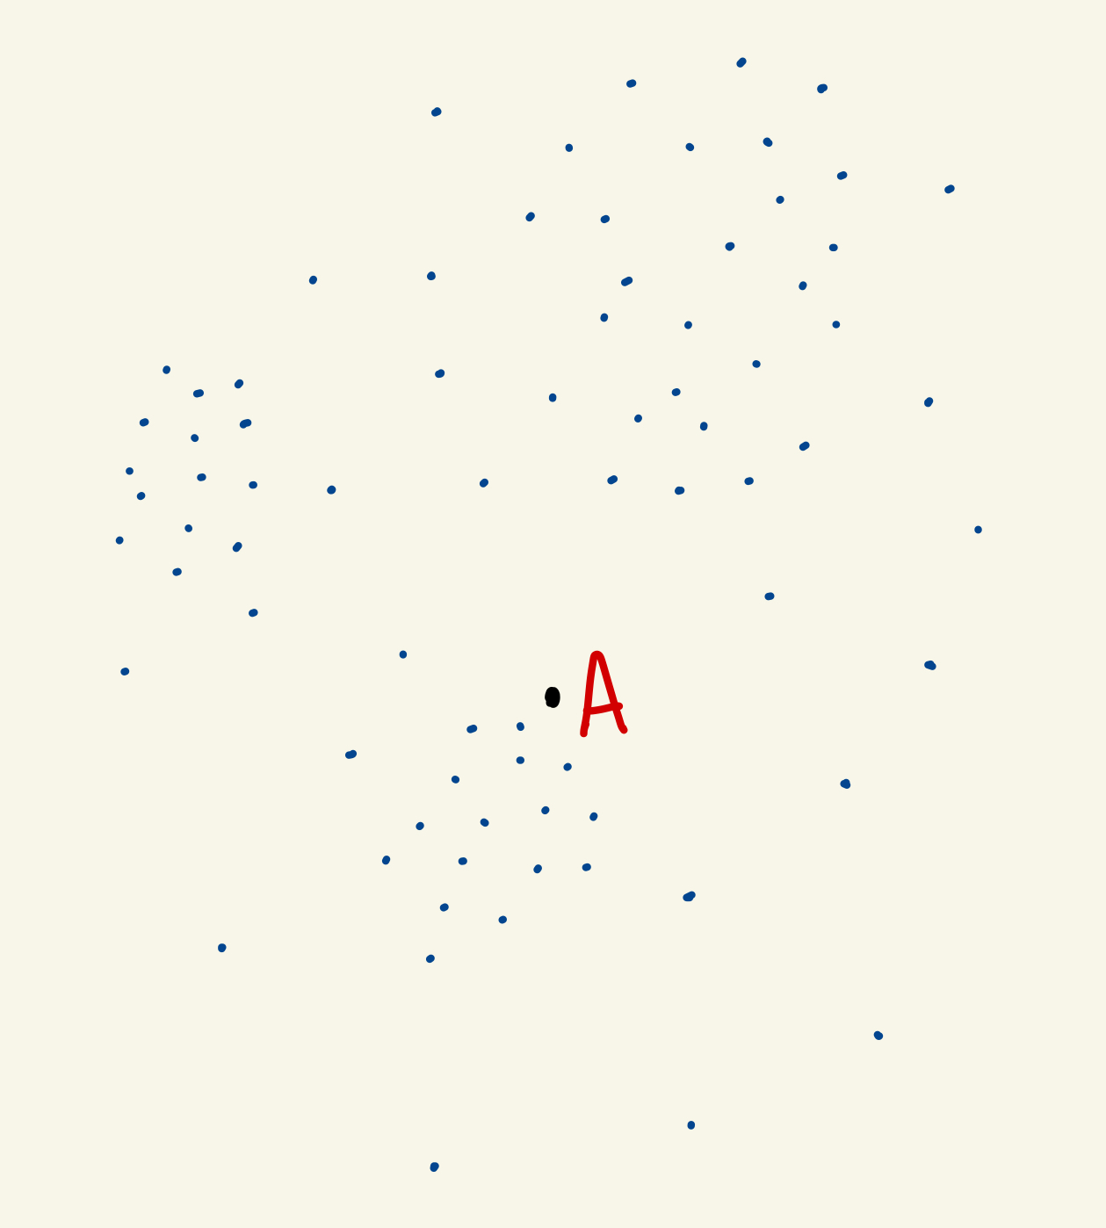
Creating the data

Slide 6
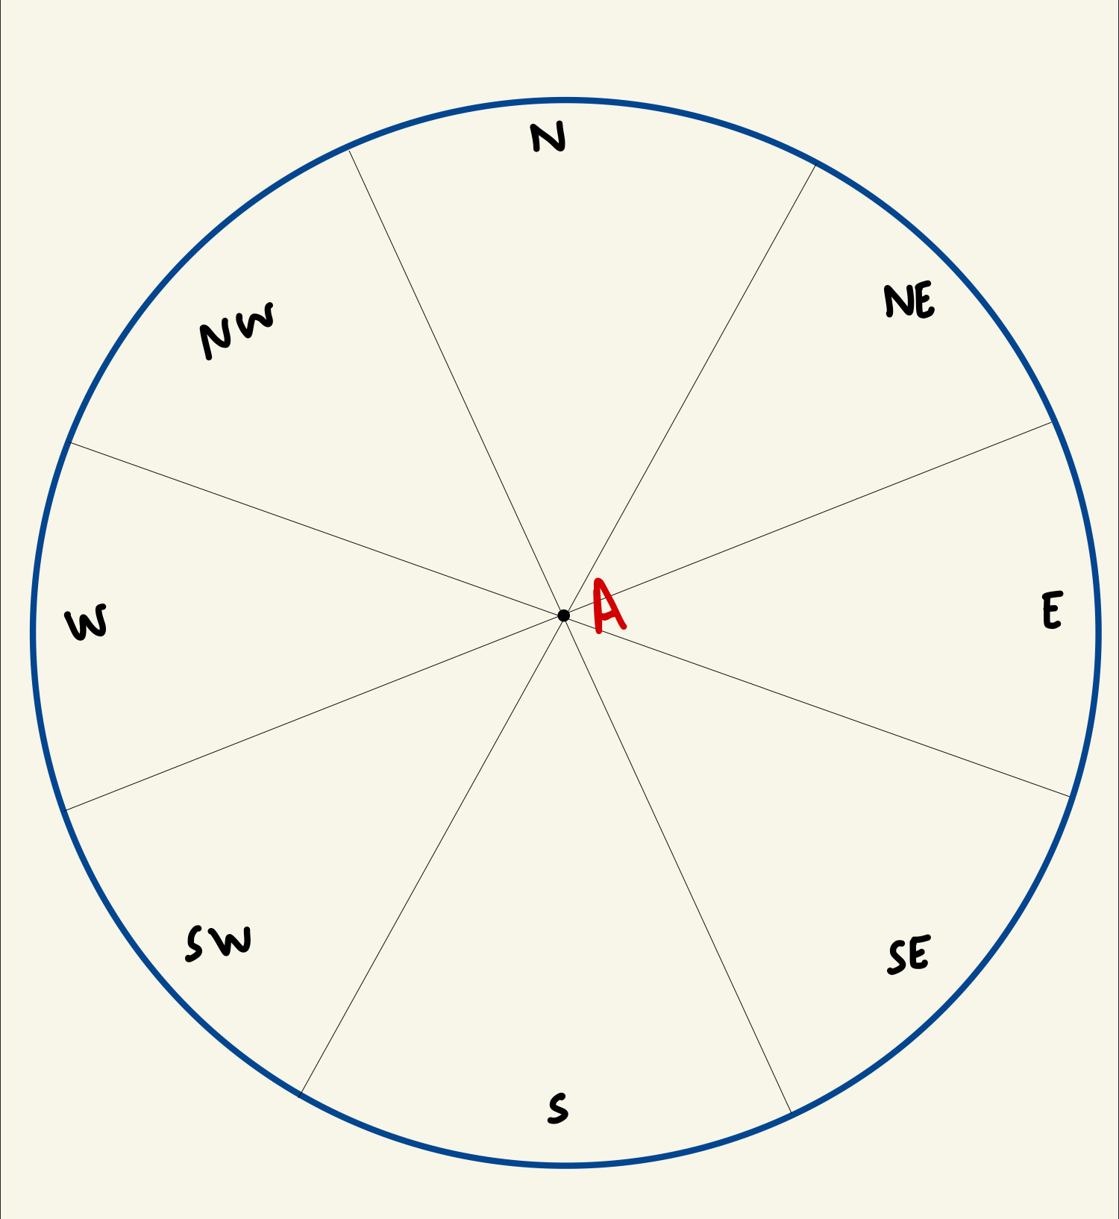
Creating the data

Slide 7
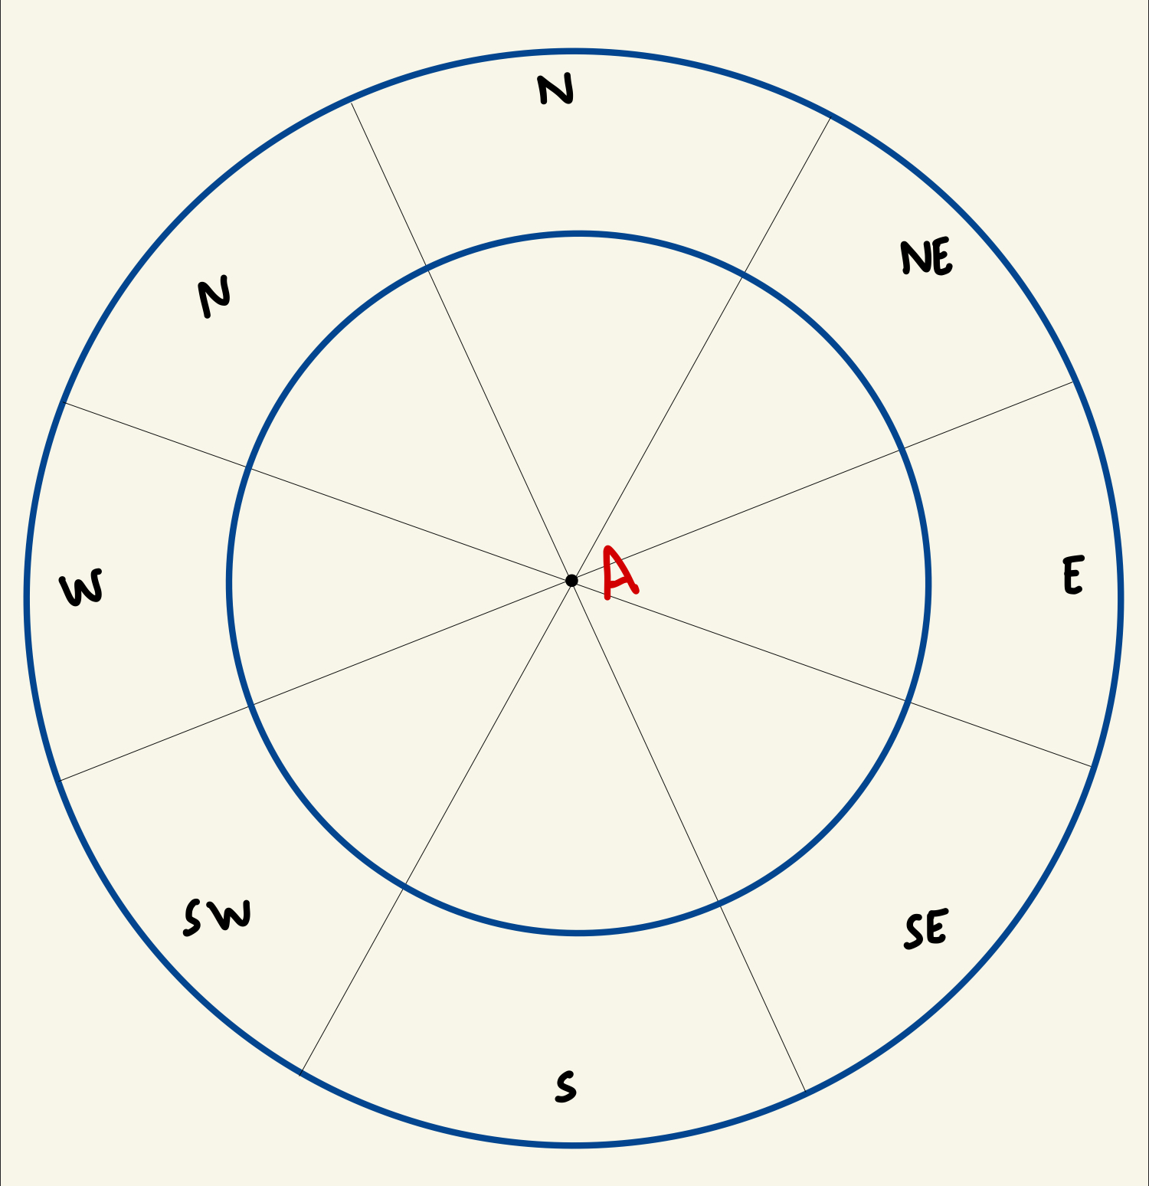
Creating the data

Slide 8
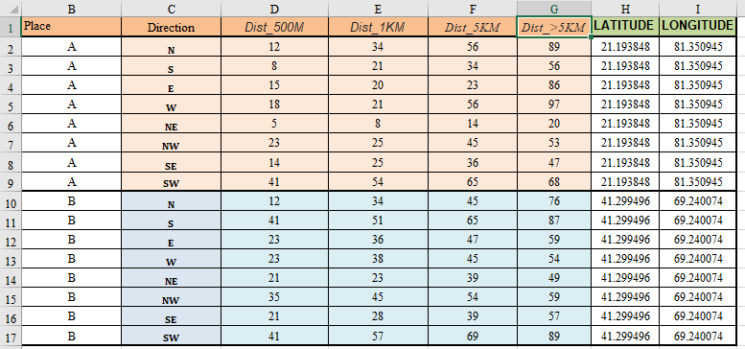
Creating the data

Slide 9
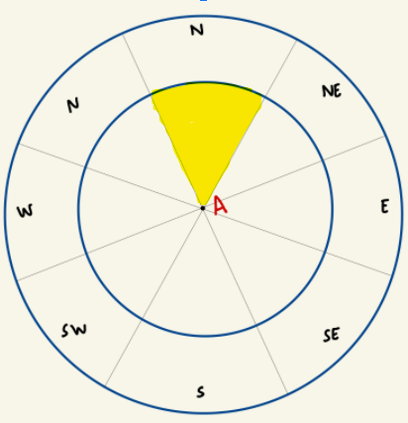
Creating the data

Slide 10
QUERY
Number of COVID19 cases in the given direction within a fixed distance.
select gis_dummy1.Dist_5kM
from gis_dummy1
where gis_dummy1.Place = 'A'
AND gis_dummy1.Direction = 'N'

Slide 11
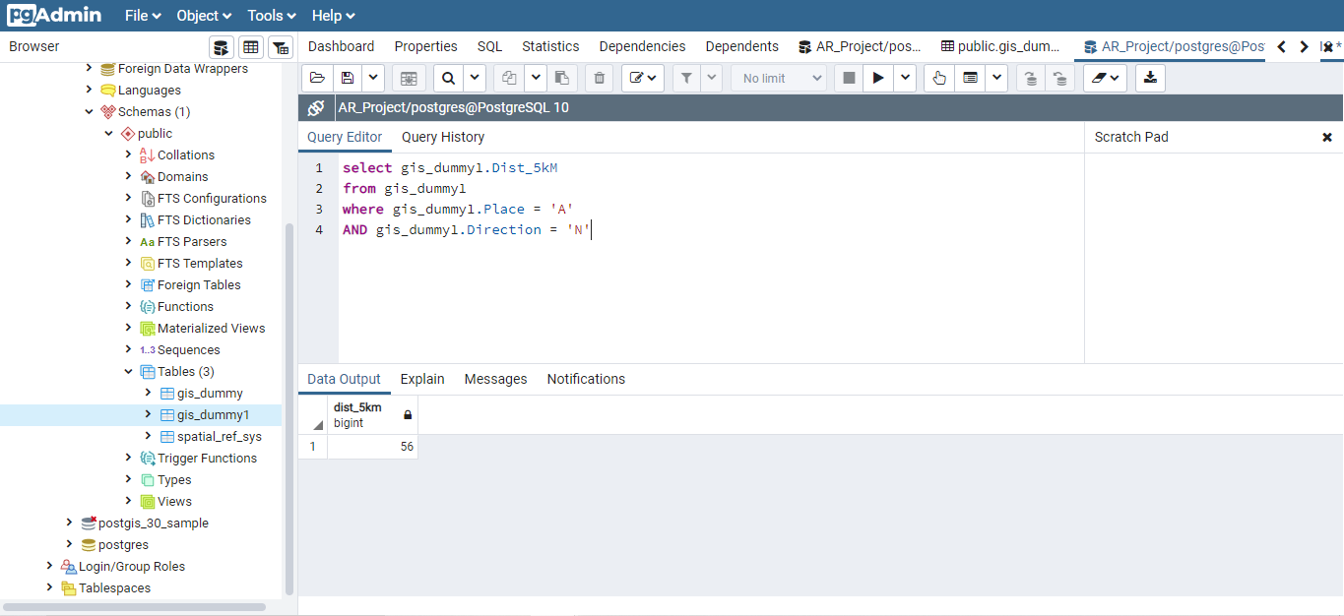

Slide 12
PROJECT STEPS
Created the data in table form in excel
Exported it as .csv (comma-separated values) file
Converted .csv to .shp (shapefile) in QGIS
Used PGADMIN to run a query after importing .shp file using POSTGRES
Developed the android app in UNITY3D (Vuforia engine for AR)
Established a server connection between PGADMIN and UNITY3D
Used the query result from PGADMIN in our android app

Slide 13
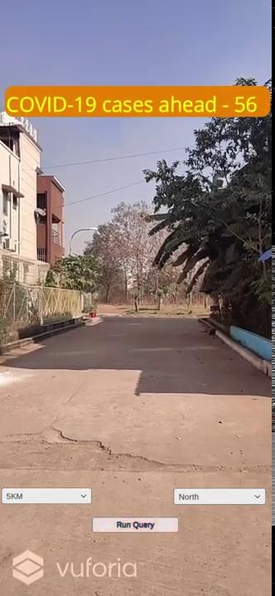
The final result
Video demonstration (PROTOTYPE) :

Slide 14
Application Areas
To find alternate routes to busy places like markets.
To monitor places where the lockdown restrictions are not being followed

Slide 15
Further improvements to be made in the project
Incorporate a compass inside the app to automatically detect the direction the camera is being pointed
Make a server connection between SQL query and android application
Find a way to update the real time data values of COVID cases

Slide 16
THANK YOU FOR YOUR ATTENTION

